Slide 1
Generating Anime Character Faces Using ACGAN’s
Course: Neural Network And Deep Learning (COMP 8610)
Submitted To: Dr.Alioune Ngom

Slide 2
Submitted By
Aaditya Pradipbhai Parekh
School of Computer Science
University of Windsor
Windsor,Canada
SID:110084734
DhruvKumar Arvind Patel
School of Computer Science
University of Windsor
Windsor,Canada
SID:110055817
Aayushi Navinchandra Patel
School of Computer Science
University of Windsor
Windsor,Canada
SID:110087817
Mrinal Singh Walia
School of Computer Science
University of Windsor
Windsor,Canada
SID:110066886

Slide 3
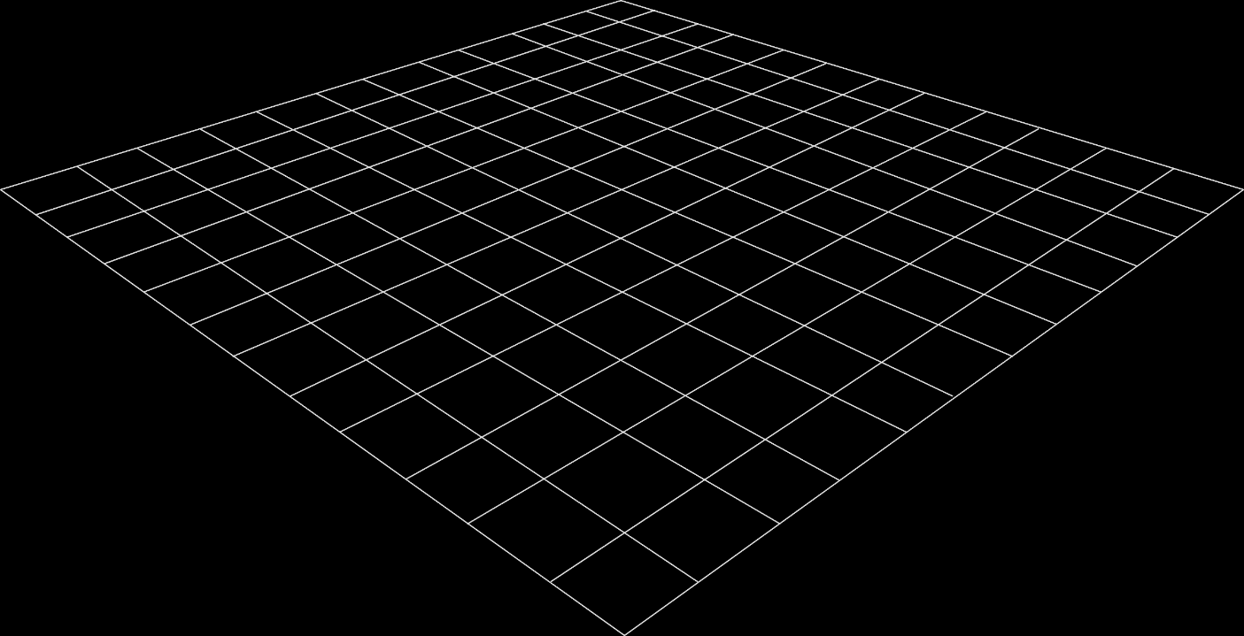
Contents:
Related work
Computational Experiments
Introduction
Abstract
Problem Statement
Methodology
Conclusion

Slide 4
1.Abstract

Slide 5
Abstract
This paper will implement a baseline Auxiliary Classifier Generative Adversarial Network capable of generating new anime character faces. We aim to design a style-guided discriminator and a generator network and train it on 63,000 synthesized anime faces. ACGANs can be notoriously hard to train as the generator, and the discriminator architectures are susceptible to parameters, hyperparameters, regularization, learning rate, and activation functions. However, unlike a conventional GANs network, our proposed framework uses a GPU for faster training and can improve its performance given more c­­omputational power and datasets.
This problem has previously been solved but lacks a generic architecture. Hence, our proposed framework can be used as a baseline network across different applications of GANs. The generated anime faces from our final model are visually pleasing and resemble designer-generated characters. As generative modelling is an unsupervised task and does not expect images to have labels, the dataset used in this project has 63,000 unlabeled cropped anime faces available at this URL: https://github.com/bchao1/Anime-Face-Dataset.
.

Slide 6
2.Introduction

Slide 7
2.Introduction
Due to the fabulous results shown and generated by GANs in the past decade, one of the studies that we will examine in this paper has previously been considered a bit complex due to the requirement of high computational power and the amount of dataset required to achieve the highest accuracy possible.
This paper is focused on Generating anime character faces using ACGANs, which stands for Auxiliary Classifier Generative Adversarial Networks.
Like most true artists, three French students utilized the power of GANs by borrowing some open-source code to put the first A.I. painting in Christie's auction and were able to sell the portrait for $ 432K
Although GANs have particular use cases mainly depending on the different domains, it is widely used to interpolate new faces, generate high-quality images, and generate face generation

Slide 8
2.Introduction [Cont.]
Generative adversarial networks (GANs) are a primer for developing a custom neural network to learn to yield new, synthetic examples of data that can pass for actual data. There are two neural networks, Generator and Discriminator, pitting against each other.
You can feed the network a sample of random noise as input, and they can contest with each other to evolve more precisely in their projections.
GANs are considered applications in almost any field creativity is an essential element. From image, voice, and video generation to supreme research in biomedical research, GANs have proved their potential by providing innovative solutions.

Slide 9
3.Problem Statement

Slide 10
3.A Problem Definition
A.I. is booming in every domain. The realism it is in solving various problems in Image Processing is outstanding.
However, the evaluation of photo realism of AI-synthesized faces indicates a gap in the algorithms needed to achieve the desired goals in the desired computational time and simplicity.
These high-quality relational faces from ACGANs are used to improve the performance of relational faces over the natural source and help generate meaningful experimental results

Slide 11
3.B Motivation
The motivation to take this method of specialized GANs and work in image synthesis is the computational advancements in A.I. According to the recent theory suggestions.
The accuracy is affected by the datasets and the approach used to define the problem.
To examine the possibility, we examined results from different research papers with different approaches to understand the current state of the face generation problem.
We concluded that there are many possibilities to be taken care of, and from the application side, it has endless options.

Slide 12
3.C Justification
Face generation has been considered the most incredible idea in A.I. technology in the last 20 years.
The best method behind the news of artistic style transfer, face-swapping, natural voice generation, music synthesis, innovative image generation, etc., is a kind of A.I. called a GAN.
The task of interpolating new faces from an existing dataset has proved to be achieved with state-of-the-art results from the different types of the GANs architectures

Slide 13
4. Related Work

Slide 14
4.A Related Work
Usually, people do not understand how neural networks and deep learning is impacting our daily lives.
When we see the results of the work, it is when we become aware of what is happening around us in the technological space.
Therefore, the generation of fake faces using artificial intelligence and machine learning has become a growing concern for every tech news magazine in the late 2020s.
Not everyone could guess the faces generated by the state-of-the-art GAN network. The results are astonishing to see how well technology has evolved in the last five years.
There were other experiments done using GANs. To generate fine-grained cartoon faces for multiple categories of sufficient training data while the given new group samples extend the basic model by creating a basic translation model for the entire group

Slide 15
4.B Background Study
In the history of artificial intelligence, this problem has been solved before using a conventional neural network which was not very close to a GAN network.
As the neural network was getting good at predictions of unseen statistics, it was a good approach and had recently become good at engaging in dialogue.
The fake portraits generated look very realistic, and it is frightening how A.I. can generate faces for itself and look so accurate as a human face

Slide 16
5.Methodology

Slide 17
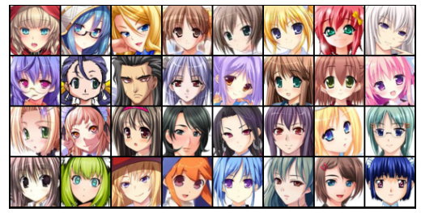
5.A Material & Data
The anime face dataset we have employed is publicly open at Kaggle at the URL: https://www.kaggle.com/datasets/splcher/animefacedataset.
The dataset contained more than 63K images of high quality but remembered not the actual faces, only the anime faces.
The folder contains 63632 images in high-quality scraped from the website getchu, and then the images were cropped using the algorithm bcpcascasde.
The size varies from 90*90 to 120*120 pixels for each image, so you can rescale them before using them

Slide 18
5.B Proposed Model
The approach we have suggested to work on generating realistic images of anime characters' situations is the class of GAN named Auxiliary Classifier GANs with regular training [13]. and softmax cross-entropy loss.
Our project presents the gradient exploding in the classifier and casting input vectors into a team of the hypersphere.
The Reagan benefits of the state-of-the-art algorithms are the model weights and a software package that provides implementations of representing cans and all experiments in our paper.
Below can be seen the two generators and the discriminator model architecture in detail as we have implemented.

Slide 19
5.B Proposed Model[Cont.]
DISCRIMINATOR NETWORK: The discriminator network is simply a classifier that takes an image as input and tries to distinguish accurate data from the data generated by the generator network.
GENERATOR NETWORK: The generator network is a part of GAN architecture that learns to create fake anime faces with the help of a discriminator network and by using a vector of the matrix of random numbers, which is used as a source for generating an image

Slide 20
5.C Conditions & Assumptions
Conditions
The discriminator network gives us a prediction of 1 if the predicted image was selected from the real Anime Face dataset, and it will give us a 0 if the image was generated using the generator part of the network.
We pass a batch of natural images to compute the loss and set of target labels to 1
We are also passing a different batch of fake images generated using the generator directly into the discriminator network, and this is done to compute the loss, and we are also setting the target labels to 0
Finally, we add both losses and apply them to the overall loss value to calculate the gradient descent and adjust the discriminator network weights
Assumptions
The generator network gives us a batch of generated face images to pass into the discriminator network.
We calculate the loss by setting the target labels to 1, meaning natural, to fool the generator's network.
We are using a loss function to perform the gradient descent, which is the change in the generator network weights. It gets better at generating actual type face images to fool the discriminator network by reaching the end of the training epochs.

Slide 21
5.D Formal Complexity
We operate the fit method from the neural network library PyTorch that trains the discriminator network and generator network in resemblance to individually other for each batch of the provided input training data.
For optimizing the loss, we are using a binary cross-entropy loss function with Adam Optimizer as an activation function with some additional custom parameters that are well known for the discriminator-generator network

Slide 22
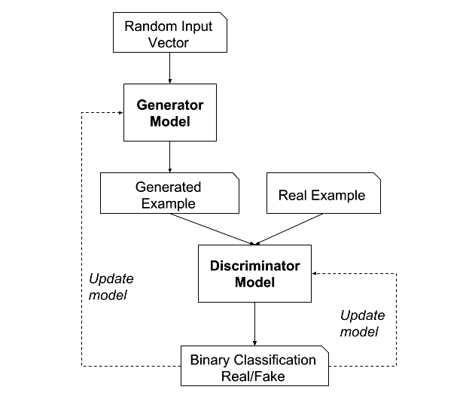
5.D Formal Complexity[Cont.]
FIGURE OF FULL NETWORK IN TRAINING

Slide 23
6.Computational Experiment

Slide 24
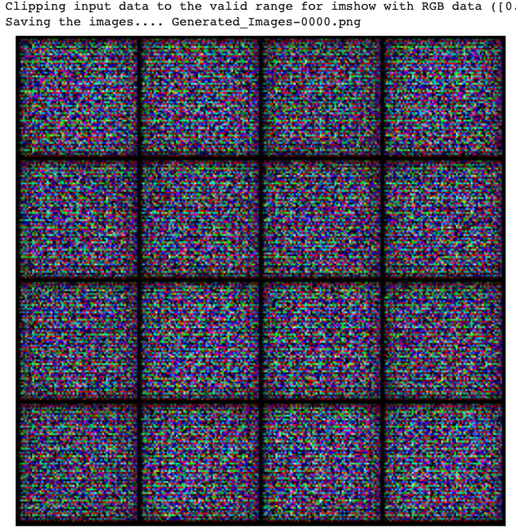
6.A Formal Complexity[Cont.]
The network we have designed in the project is a complex GAN network with two main components: A generator and a Discriminator. After seeing the design of the architecture in the previous section, we tuned the parameters and hyperparameters to change the model's performance and validate the results.

Slide 25
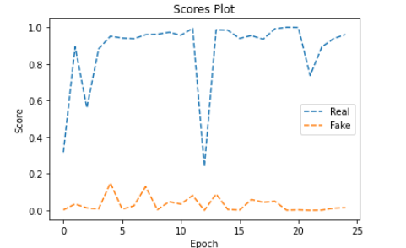
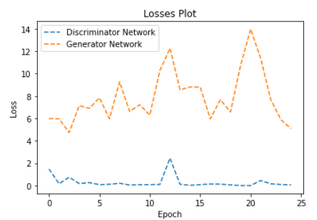
6.B Evaluation Matrix (F1 Score)
We evaluate the model after every 10-epoch value by saving the model's output prediction locally.
We have used the log metric method of the Jovian library in Python and machine learning.
It allows us to save the loss of generator and discriminator and the actual and fake scores for the model.
.

Slide 26
6.C Implementation Details
. Implementation
Platform: Anaconda + MacOS Terminal
Toolkits: Visual Studio Code, GitHub, Git (for source control) Software's and Libraries: Python 3.7, PyTorch, keras, numpy, pandas, GANs Algorithms, Matplotlib
2. Hardware
Processor – 2.8 GHz M1 Chip
Ram – 8GB 1600 MHz DDR5
GPU – Apple M1 Bionic
OS – MacOS Big Sur (Version 11.6.5)
.

Slide 27
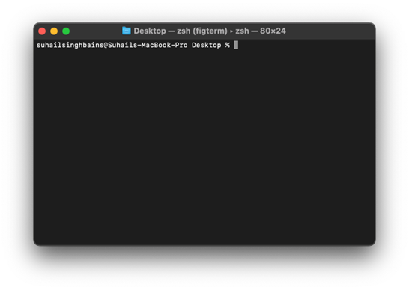



6.C Implementation Details[Cont.]
.

Slide 28
6.D Result
We achieved an accuracy of 97%, and the model's accuracy can be stretched up to 99.8% with more computing, processing power, and resources.
We will show the incremental results, showing the generated output of anime face characters from every five epochs until 25 epochs.
When we compare the results, it is observed clearly how the generator network is generating better real-anime character faces with every epoch and how the discriminator is getting fooled at understanding the almost real-like generated faces images.
.

Slide 29
6.D Result[Cont.]
For our feature-based approach, we analyze features that reveal that the most important features are those that combine the pre-polarity of words with their part-of-speech signs. We first concluded that the analysis of Twitter data is not significantly different from the analysis of other types of emotions.
Positive vs. Negative Statement Analysis. This is a binary classification task with two classes of emotion polarity: positive and negative. Use a balanced dataset of 1709 samples for each class and therefore a 50 per cent probability base..

Slide 30
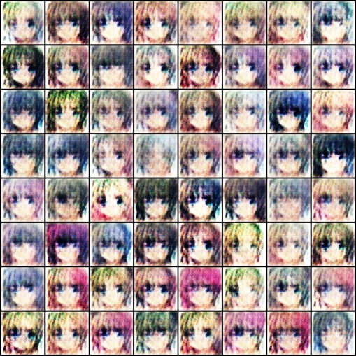
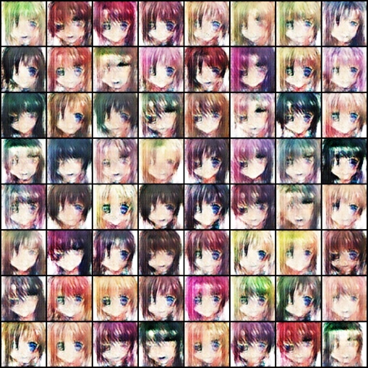
6.D Result[Cont.]
^{Epoch-1}
^{Epoch-5}

Slide 31
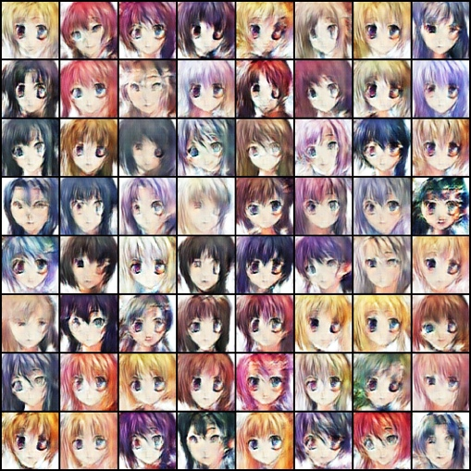
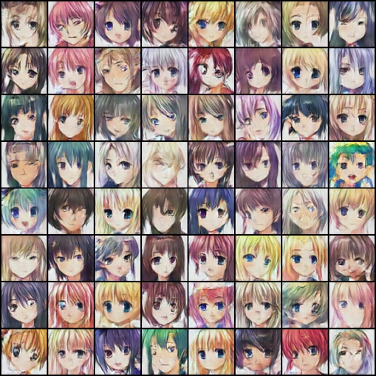
6.D Result[Cont.]
^{Epoch-10}
^{Epoch-15}

Slide 32
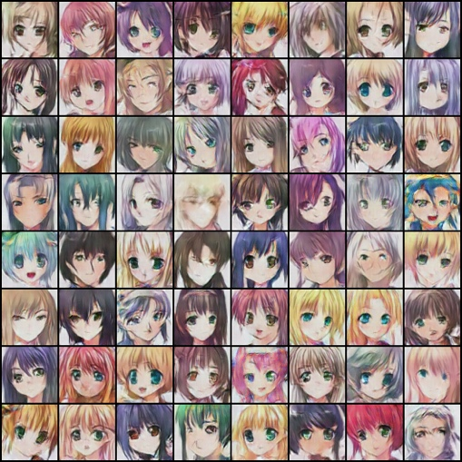
6.D Result[Cont.]
^{Epoch-15}

Slide 33
6.E Discussion
As we can see from the plots, the loss of the discriminator network at 25 epochs is at a value of close to ~ 0.2, and the loss for the generator network is at ~ 2.
And from another figure, which is for the accuracy score, it can be seen that the authentic images have an accuracy of close to ~ 97%. In contrast, the ACGAN network gives a precision on the fake dataset of ~ 12%.
Now what we are observing from the above image, we can say that the network could perform much better if trained at 500-1000 epochs.

Slide 34
7.Conclusion

Slide 35
7.A Summary
In this report, we have discussed the anime character face generation using a computational approach to make the new data.
The motive behind this project was to help the business, communication and tech industries explore the prospects of the GANs architecture, which is comparatively new in this generation of computers.
We proposed a network of neural networks in the discriminator and the generator algorithm.
We have used a deep neural network at the core, mainly used for unsupervised learning like generative modelling.
Machine learning involves automatically discovering the learning qualities and patterns in the given dataset.
This way, the model can generate new output or examples that have never been drawn from the inputs.

Slide 36
7.B Future Research
Although GAN networks have improved in the last few years, many areas remain to work on. Current progress from simple low-resolution images to high-resolution images in the predicted outcome can be achieved.
The cutting-edge augmented reality feature is another future aspect to improve and work on. How can the generated faces be more realistic and in 3-dimension? This can be achieved by working on the A.R. feature of the GAN modelling.

Slide 37
7.C Open Problems
The open problems to work on in this project can be finding the trade-off between using different GANs and other generative models and what sort of distributions these different models generate.
This will also help to scale the GANs beyond image synthesis and can be further expanded to say about the global convergence of the training dynamics, how we evaluate the GANs and what we should use to scale training with batch size.
One more point to add here is the relationship between GANs and their adversarial examples that can further be explored.

Slide 38
Thankyou

